Slide 1
Chapter 9: Virtual-Memory Management

Slide 2
Chapter 9: Virtual-Memory Management
Background
Demand Paging 需要的時候才載入
Copy-on-Write
Page Replacement
Allocation of Frames
Thrashing 連續 擊 打或 ,揮 ,動
Memory-Mapped Files
Allocating Kernel Memory
Other Considerations
Operating-System Examples
Notes:
ch8是進化成proc載到mem可以放不連續 但是還是要完全載入 ch9是再進化可以不連續 而且不用全部載入 可以載入部分 其他的用到再載入就可以了
copy on wr : ex parent process 產生child proc 兩個共享一部分記憶體 如果任一proc對share mem進行修改 改了之後兩個就不一樣 就copy一份出來做出區別
page repl: demand page要把page下載到mem時 發現mem都已經滿了 就要找一個mem裡的page換出去 swap out
alloc frame: mem切成frame proc切成size, 一個程式執行時要給他幾個frame ex 10page OS給他10 frame 那就不用replace 10page 5 frame就需要replace OS重要的工作
thr : 如果要一個page 剛好不在frame 那就是page fault 就會引發page rplacment 下載進來 很花時間 如果情況一直發生 就叫thr 也就是CPU花很多時間再處理page falut IO 會介紹怎麼解 可以用working set解

Slide 3
Objectives
To describe the benefits of a virtual memory system 1 logical addr space 可 > phy addr spa
To explain the concepts of demand paging, page-replacement algorithms(會介紹五六種), and allocation of page frames vvv
To discuss the principle of the working-set model
分配多少個frame跟proc是CPU or IO bound 有關, working set是利用locality 附近的資料經常被用到 所以抓了一個page 就把附近的一起給他 可以觀察執行歷史 花了幾個frame 推測目前需要幾個 跟排班系統話務預測 差不多 上面的手段都是為了避免page fault因為代價大
Notes:
9-1 end

Slide 4
Background
Virtual memory – separation of user logical memory from physical memory.
Only part of the program needs to be in memory for execution 最重要的概念 proc只需部分放進mem
Logical address space can therefore be much larger than physical address space
Allows address spaces to be shared by several processes 因為只放一部分 所以可更多人分享
Allows for more efficient process creation 部分載入
Virtual memory can be implemented via:
Demand請求 paging proc,page mem,frame固定大小
Demand segmentation 程式切割用subroutine function…等 不固定大小
Notes:
demand XX : 真正要用到時才下載 把logical mem 跟 physical mem 分開發展使用 靠virtual mem串起來 就能做到只需部分logic放到 phy就能跑 logic addr mem 是CPU針對某個proc產生的一大串位址 部分載入的進化是 原本程式大小 > mem 就不能跑 部分載入就是 程式大小 > mem 還是能跑 記憶體可更有效管理

Slide 5
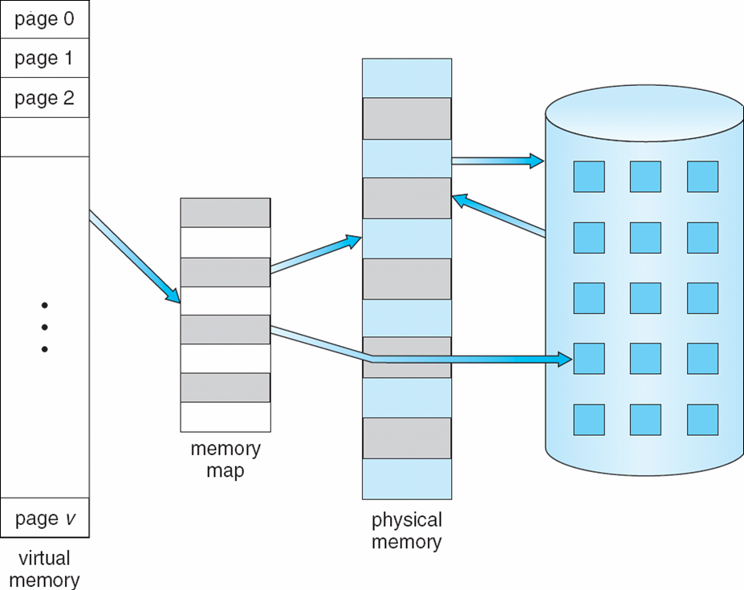
Virtual Memory > Physical Memory
Page replacement
Demand paging
⇒
Notes:
恩

Slide 6
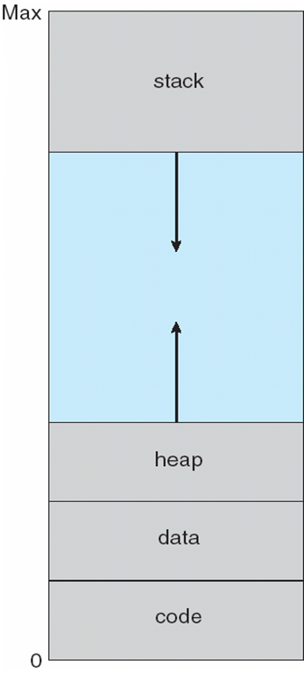
Virtual-address Space
Notes:
max可以很大 比phy大

Slide 7
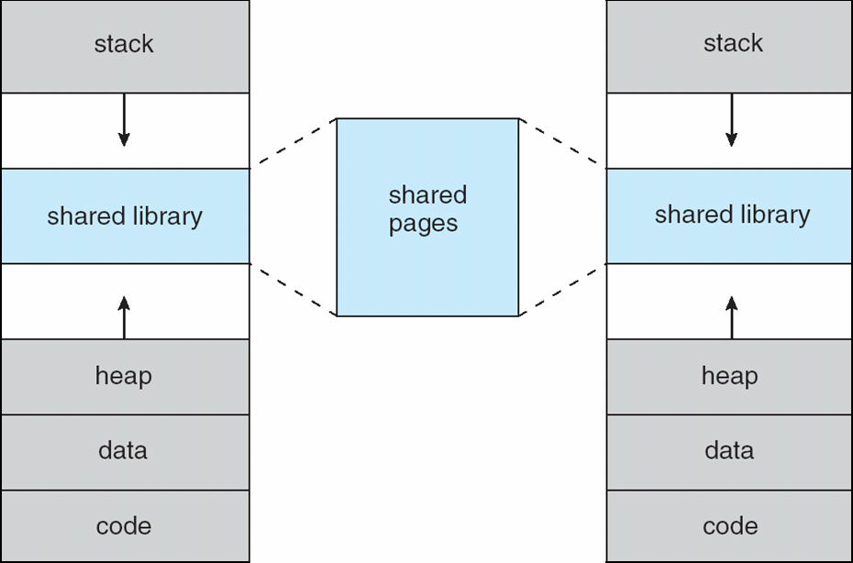
Shared Library Using Virtual Memory
Notes:
share也ok

Slide 8
Demand Paging
Bring a page into memory only when it is needed(eg 需要page裡的 data or instruction)
Less I/O needed
Less memory needed
Faster response 只搬需要的少量 比較快花時少
More users 可以放更多proc
Page is needed ⇒ reference to it
invalid reference ⇒ abort
not-in-memory ⇒ bring to memory
Lazy swapper搬動的程式 – never swaps a page into memory unless page will be needed
Swapper that deals with pages is a pager
Notes:
invalid reference ⇒ abort 例如寫到其他proc位置 OS要保護 就要終止 4-2 end

Slide 9
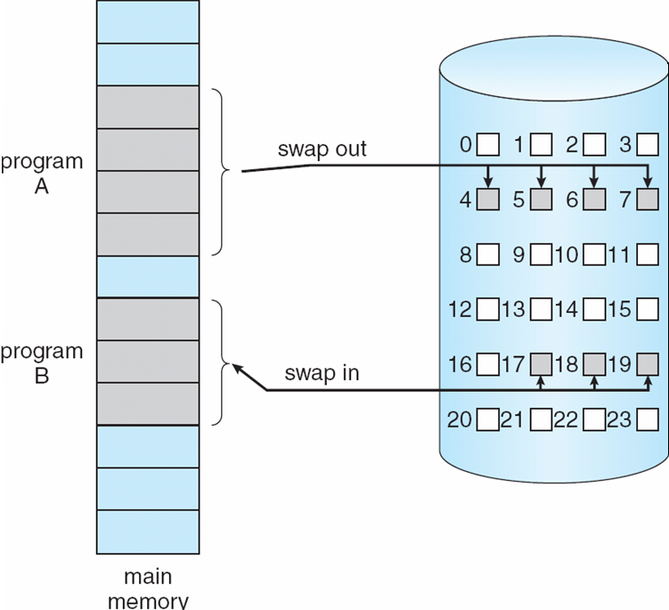
Transfer of a Paged Memory to Contiguous Disk Space
Notes:
4-2 end 4-3 start左邊mem 一個個frame 右邊disk 一個個block 左右邊塗上是連續 實際上可以不連續看實作機制 swap out A in B

Slide 10
Valid-Invalid Bit
With each page table entry a valid–invalid bit is associated (v ⇒ in-memory, i ⇒ not-in-memory)
Initially valid–invalid bit is set to i (invalid)on all entries
搬進來之後才設成設成 valid
Example of a page table snapshot:
During address translation, if valid–invalid bit in page table entry is i ⇒ page fault
Frame #
valid-invalid bit
v
v
v
v
i
….
i
i
page table
Notes:
想找一個page 到底在不在記憶體 就看valid-invalid bit 每個proc都有page table紀錄page跟frame的對應 之前是所有page都放到記憶體 現在只放部分 所以要知道那些在那些不在

Slide 11
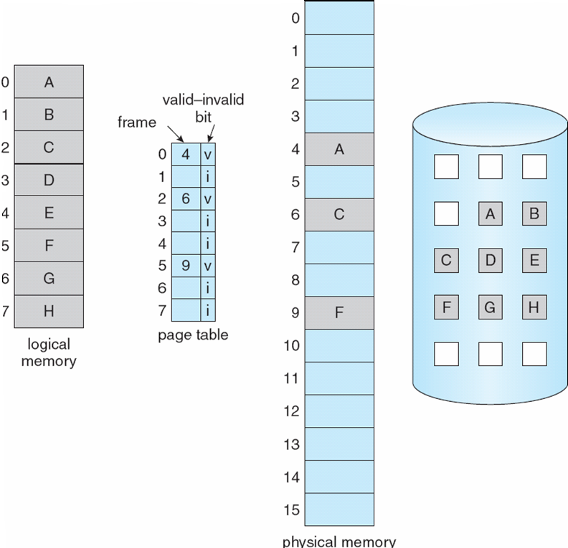
Page Table When Some Pages Are Not in Main Memory
Notes:
程式有8個page 只放ACF 在page table 和mem 就是v 其他i

Slide 12
Page Fault
If there is a reference to a page, first reference to that page will trap to operating system:
page fault
Operating system looks at another table to decide:
Invalid reference ⇒ abort e.g超出自己範圍 別人的 就不能用
Just not in memory
Get empty frame from physical memory 拿mem
Swap page into frame from disk 換disk
Reset tables
Set validation bit = v 產生page fault重load相當於IO 所以會進入wait > IO完再ready 6再啟動
Restart the instruction that caused the page fault
Notes:
第一次讀某個記憶體區塊時 一定不在page table 所以就會丟錯誤trap給OS 第二次之後就不一定 看有沒有被replacement

Slide 13

Steps in Handling a Page Fault
v
Notes:
要取叫M的 page > table不在 > trap 給OS (proc被拉到IO等)> page載入到空的frame (proc可能就搬回ready 等待CPU) 回寫page table > 繼續執行instr

Slide 14
Performance of Demand Paging
Page Fault Rate 0 ≤ p ≤ 1.0
if p = 0 no page faults
if p = 1, every reference is a fault
Effective Access Time (EAT)
EAT = (1 – p)沒fault x memory access
+ p (page fault overhead
+ swap page out
+ swap page in
+ restart overhead)
Notes:
9-4

Slide 15
Demand Paging Example
Memory access time = 200 nanoseconds
Average page-fault service time = 8 milliseconds
EAT = (1 – p) x 200 + p (8 milliseconds)
= (1 – p ) x 200 + p x 8,000,000
= 200 + p x 7,999,800
If one access out of 1,000 causes a page fault, then
EAT = 8.2 microseconds. (8+1000*0.0002)
This is a slowdown by a factor of 40!!
Notes:
1/1000 就4 0倍 所以盡量不要產生page fault

Slide 16
Process Creation
Virtual memory allows other benefits during process creation:
- Copy-on-Write
- Memory-Mapped Files (later)
Notes:
ok virtual mem兩種方式proc creat

Slide 17
Copy-on-Write
Copy-on-Write (COW) allows both parent and child processes to initially share the same pages in memory
If either process modifies a shared page, only then is the page copied
COW allows more efficient process creation as only modified pages are copied
Free pages are allocated from a pool of zeroed-out pages(沒說)

Slide 18
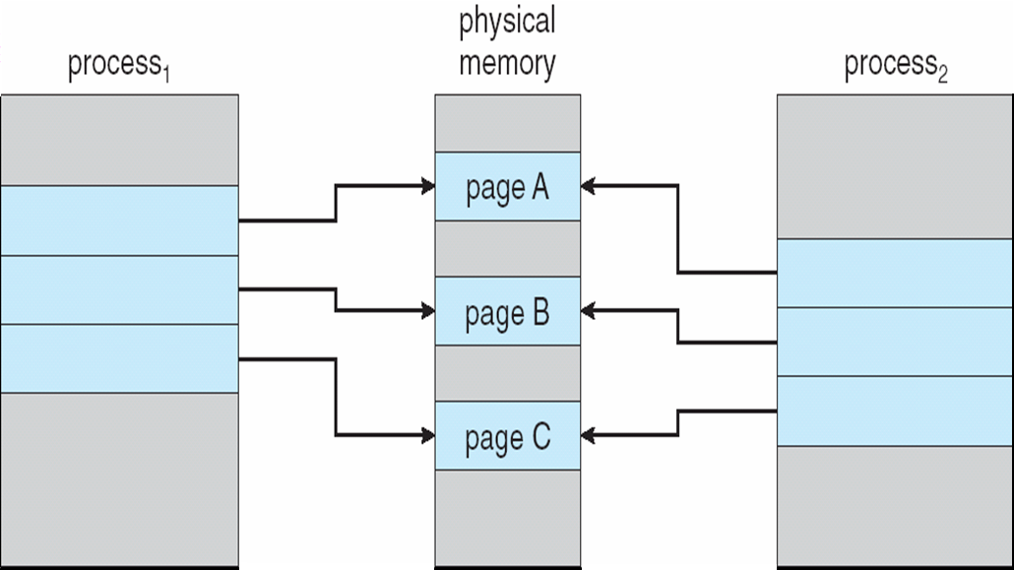
Before Process 1 Modifies Page C

Slide 19
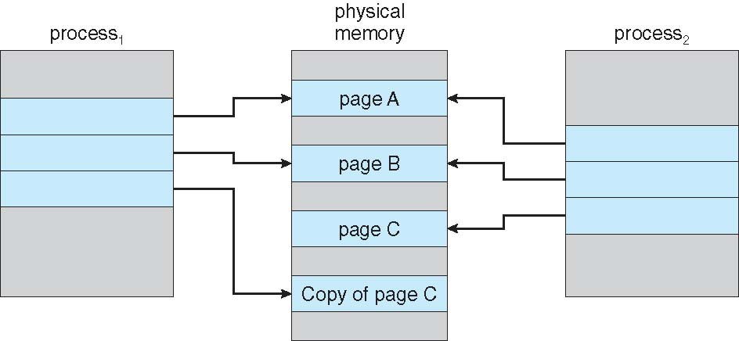
After Process 1 Modifies Page C
Notes:
If either process modifies a shared page, only then is the page copied 就是在圖說前面
COW allows more efficient process creation as only modified pages are copied

Slide 20
What happens if there is no free frame?
Page replacement – find some page in memory, but not really in use, swap it out
algorithm
performance – want an algorithm which will result in minimum number of page faults
Same page may be brought into memory several times
Notes:
記憶體滿了 就要replace

Slide 21
Page Replacement
Prevent over-allocation of memory by modifying page-fault service routine to include page replacement
Use modify (dirty) bit to reduce overhead of page transfers – only modified pages are written to disk
Page replacement completes separation between logical memory and physical memory – large virtual memory can be provided on a smaller physical memory 這些手段讓logic變很大 phy變很小
Notes:
1 給每個proc的page不要太多 才能達到更多proc共同使用mem page fault service routine: 產生page fault時 trap OS OS會找到page在硬碟的哪個地方 然後搬到主記憶體 然後做replacement 找最近很少用到的 or 未來不會用到的 page 把它replace掉 就可以避免page大量增加分配 第二點是有被修改的mem才dirty bit > mem(swap out)回寫disk
如果資料從disk搬到mem 沒被修改當然不用回寫

Slide 22
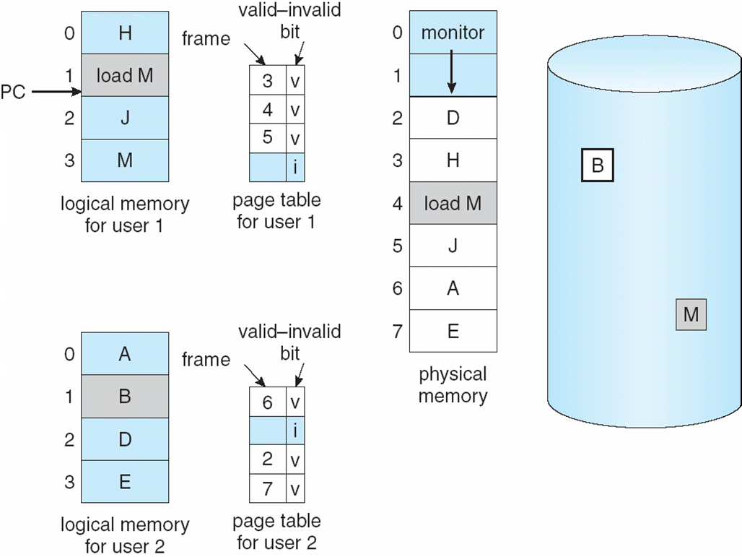
Need For Page Replacement
?
Notes:
左邊有兩個proc 各有4 page 但只有三個放在mem M還沒放 此時PC正要load M M假設是一個值要放到mem 結果發現mem已經滿了 就要replace

Slide 23
Basic Page Replacement
Find the location of the desired page on disk
Find a free frame: - If there is a free frame, use it 只下載 - If there is no free frame, use a page replacement algorithm to select a victim frame
Bring the desired page into the (newly) free frame; update the page and frame 更新那些被用掉了
Restart the process

Slide 24
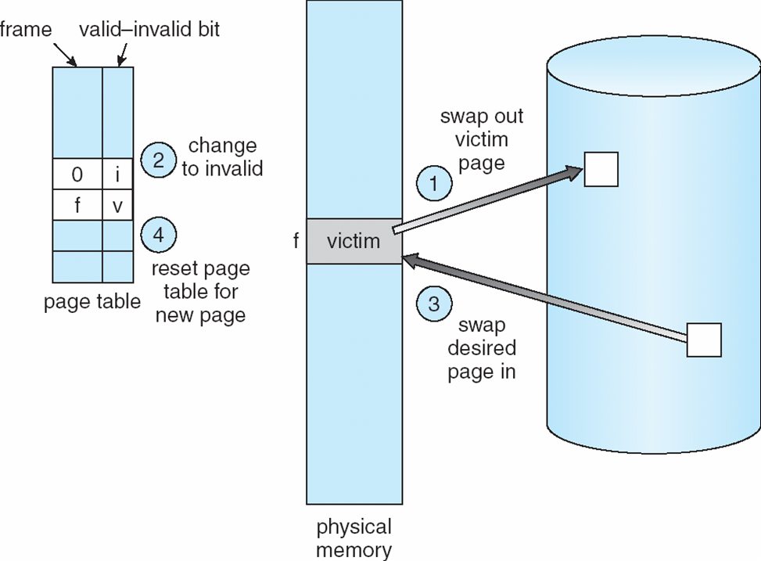
Page Replacement
Notes:
步驟 1 2 3 4

Slide 25
Page Replacement Example
i
3 v
M
H
?
Notes:
9-6 end 假設 H搬出 M搬進 H原本放在位置3 H出 更新page tbl 把3改成 i Ｍ搬進 3 改成 v

Slide 26
Page Replacement Algorithms
Want lowest page-fault rate
Evaluate algorithm by running it on a particular string of memory references (reference string) and computing the number of page faults on that string 固定用到page的順序
In all our examples, the reference string is
1, 2, 3, 4, 1, 2, 5, 1, 2, 3, 4, 5
Notes:
9-7 start

Slide 27
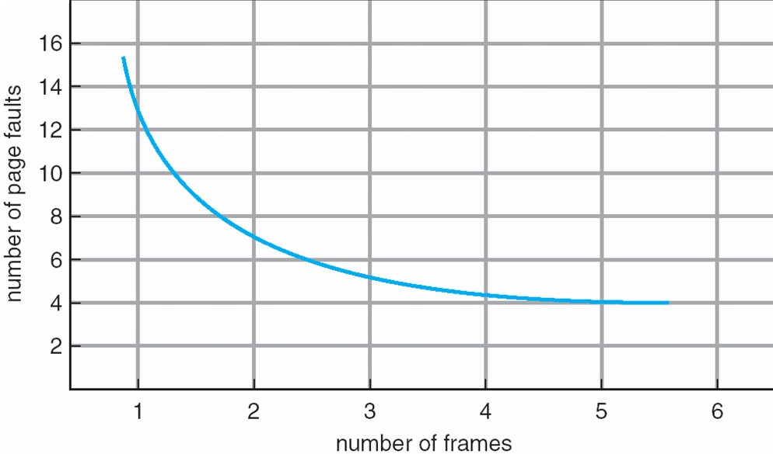
Graph of Page Faults Versus The Number of Frames
allocated for a process
Notes:
一個proc 給越多個frame page fault就越低 因為能放的page越多

Slide 28
First-In-First-Out (FIFO) Algorithm
Reference string: 1, 2, 3, 4, 1, 2, 5, 1, 2, 3, 4, 5
3 frames (3 pages can be in memory at a time per process)
4 frames
Belady’s Anomaly: more frames ⇒ more page faults
1
1
4
5
2
2
1
3
9 page faults
3
3
2
4
1
1
5
4
2
2
1
5
10 page faults
3
3
2
4
4
3
Notes:
1 2 3 先fault 4進來 FIFO 1出去 > 4f 2out1f 3out 2f 4out5f 1ok 2ok 3f 4f 5ok 但是 4 frame反而10 f 這是針對FIFO 會有這種現象 給越多 fault越多

Slide 29
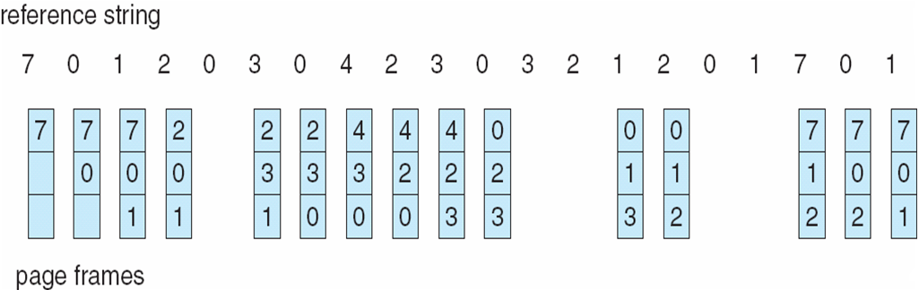
FIFO Page Replacement
Total number of page faults = 15
Notes:
藍色調代表發生 page f 紅框可以看出取代 不是像一個queue裡面的元素看起來會移動 最先的往前消失 後面多新增一個 而是在各自己的位置上面被取代 是靜態取代 不是像人潮排隊有往前位移 023是2最早進來 所以2被取代成1 這邊FIFO共有15個 可以跟後面作比較

Slide 30
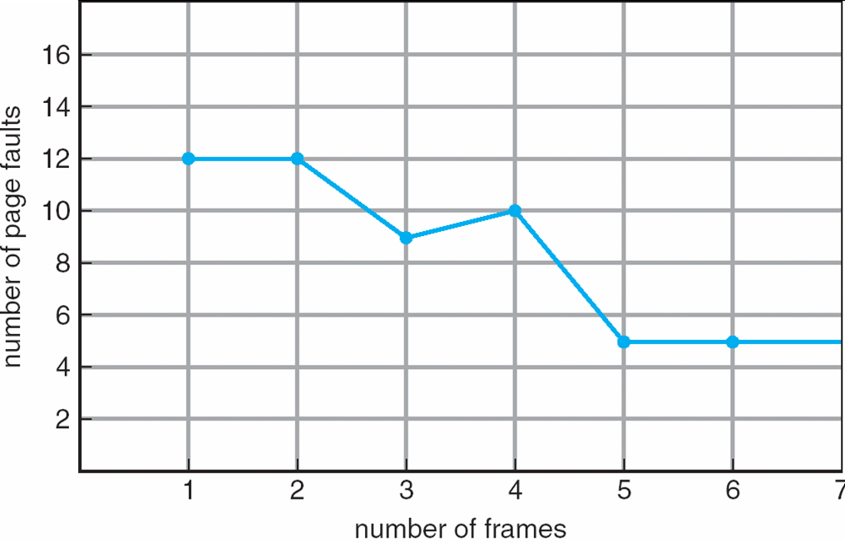
FIFO Illustrating Belady’s Anomaly
Notes:
e.g. p28

Slide 31
Optimal Algorithm
Replace page that will not be used for longest period of time (最久之後用到)
4 frames example 1, 2, 3, 4, 1, 2, 5, 1, 2, 3, 4, 5
How do you know this?
Used for measuring how well your algorithm performs (lower bound)
1
4
6 page faults
2
3
4
5
Notes:
optimal 最佳演算法 所有演算法中次數最少 換掉 最久之後才用到的frame 紅色的是page fault 取代的是黃色垂直右邊 先4>5 後1>4(4的時候123後面都沒了 隨便挑一個取代) 簡單易懂 這個演算法對於 未來的字已知有用 但實際生活無法預知未來 但可以做為lb 可以當最佳標準去比較

Slide 32
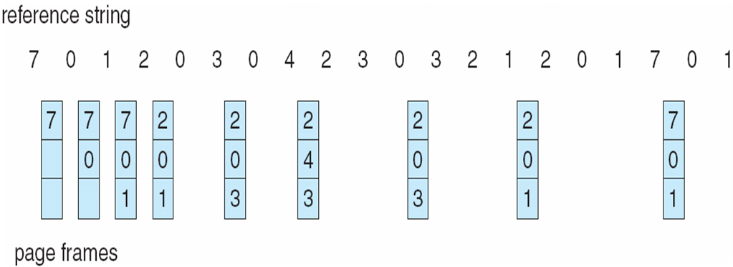
Optimal Page Replacement
Total number of page faults = 9
Notes:
FIFO 15 藍色就是發生page fault進行取代的點

Slide 33
Least Recently Used (LRU) Algorithm
Reference string: 1, 2, 3, 4, 1, 2, 5, 1, 2, 3, 4, 5
Counter implementation
Every page entry has a counter; every time page is referenced through this entry, copy the clock 系統時間 into the counter
When a page needs to be changed, look at the counters to determine which is to change
1
1
1
1
5
2
2
2
2
2
(最早之前用過)
3
5
5
4
4
4
4
3
3
3
Notes:
最近最少用的 也就是最早之前用過的 這個想法是覺得最早之前被用過的 因為被用過了 最近可能不會用 clock是可以拿系統時間最小的來取代

Slide 34
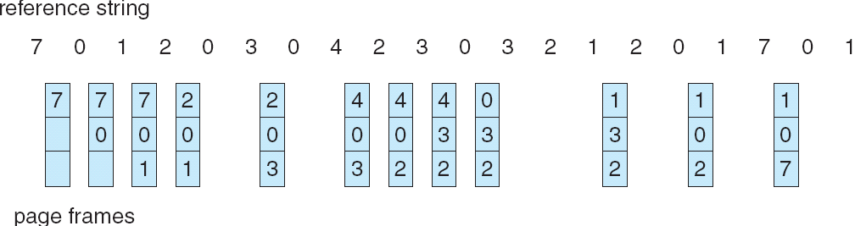
LRU Page Replacement
Total number of page faults = 12
Notes:
FIFO 15

Slide 35
LRU Algorithm (Cont.)
Stack implementation – keep a stack of page numbers in a double link form:
Page referenced:
move it to the top
requires 6 pointers to be changed
No search for replacement – Replace the bottom page of the stack
Notes:
也可以用stack來做 最新用過的搬到最上面 so最底下最LRU

Slide 36
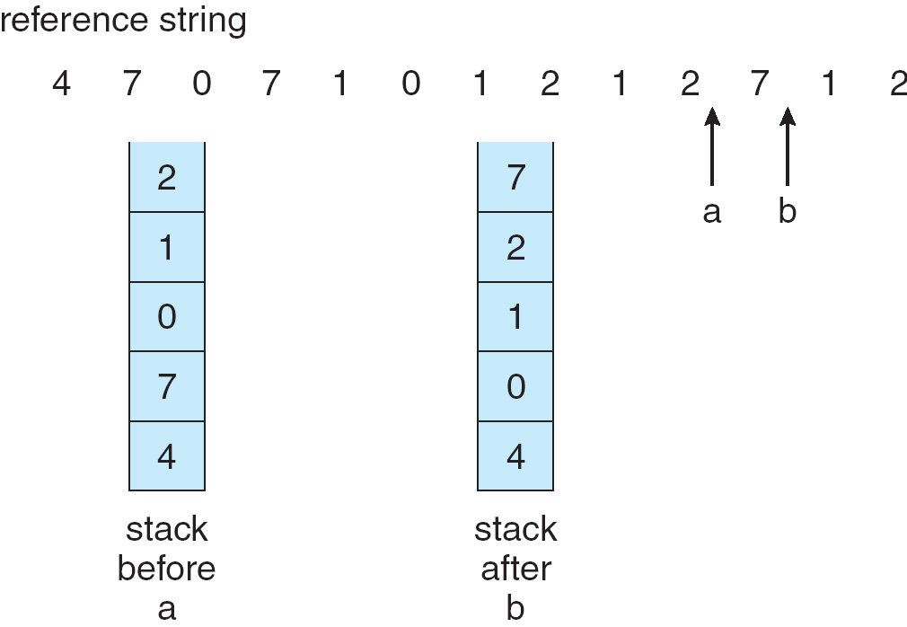
Stack implementation

Slide 37
LRU Approximation Algorithms
Reference bit
With each page associate a bit, initially = 0
When page is referenced bit set to 1
Replace the one which is 0 (if one exists)
We do not know the order, however
Second chance
Need reference bit
Clock replacement 順時鐘的檢查
If page to be replaced (in clock order) has reference bit = 1 then:
set reference bit 0
leave page in memory
replace next page (in clock order), subject to same rules
Notes:
9-9 start近似的效果 類似的作法 第一點只講這樣 我不確定會不會一下子就全部變1 就是最新用到的設為1 取代掉目前為0的 第二點就是第一點的實作 被用到的話會設成1 下次遇到會設成0留著(也就是第二次機會) 下次再檢查是0就取代掉

Slide 38
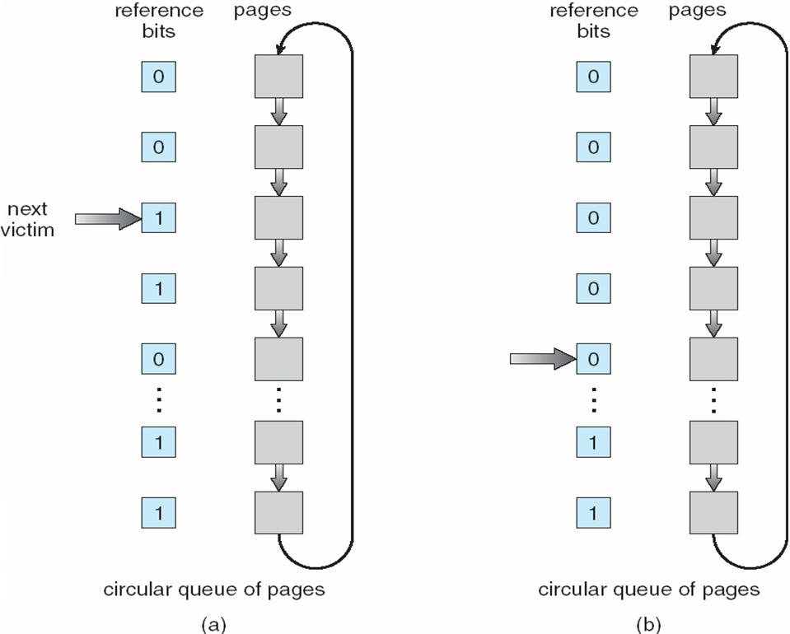
Second-Chance (clock) Page-Replacement Algorithm

Slide 39
Counting Algorithms
Keep a counter of the number of references that have been made to each page
LFU Algorithm: replaces page with smallest count
MFU Algorithm: based on the argument that the page with the smallest count was probably just brought in and has yet to be used
Notes:
前面算時間最早 這邊算次數 最小/最大 LMU是換掉最大的 但是為什麼用最頻繁的要換掉 因為count小的是最新搬進來的 代表可能會用到的 要給他們機會

Slide 40
Allocation of Frames
Each process needs minimum number of pages
Example: IBM 370 – 6 pages to handle SS MOVE instruction把一個block 搬到另一個:
instruction is 6 bytes, might span 2 pages
2 pages to handle from 用2個page紀錄起始位置
2 pages to handle to
Two major allocation schemes
fixed allocation
priority allocation 高pri可以取代別人低pri的

Slide 41
Fixed固定 Allocation
Equal allocation – For example, if there are 100 frames and 5 processes, give each process 20 frames. 平分
Proportional allocation – Allocate according to the size of process 按比例
Notes:
固定很簡單 但就不聰明

Slide 42
Priority Allocation
Use a proportional allocation scheme using priorities rather than size
If process P_{i} generates a page fault,
select for replacement one of its frames
select for replacement a frame from a process with lower priority number
Notes:
從自己的frame挑一個 或從其他pri低裡面的挑一個

Slide 43
Global vs. Local Allocation
Global replacement – process selects a replacement frame from the set of all frames; one process can take a frame from another
可以挑別人的
Local replacement – each process selects from only its own set of allocated frames 挑自己的

Slide 44
Thrashing
If a process does not have “enough” pages, the page-fault rate is very high. This leads to:
low CPU utilization 因為在等IO
operating system thinks that it needs to increase the degree of multiprogramming
another process added to the system
Thrashing ≡ a process is busy swapping pages in and out
Notes:
9-11 因為一直在等IO CPU容易閒置 multiprogramming 目標是盡量讓CPU使用率越高越好 所以會想增加執行的degree, 也就是增加 proc數 像之前講過的long term schedule mid term schedule long term的可以放進來 proc放進來 相當於要放到mem 但是mem有限 變成每個proc能分到的page越少 就會增加thrashing 惡性循環

Slide 45
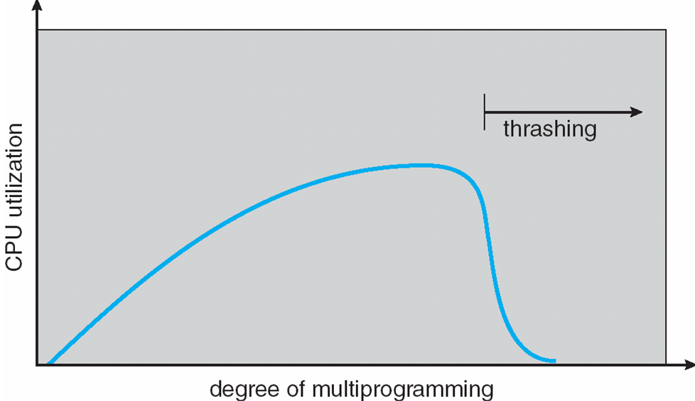
Thrashing (Cont.)
Notes:
後面下降就是因為前面講的每個proc分配到的frame 9-11 end

Slide 46
Demand Paging and Thrashing
Why does demand paging work? Locality model
Process migrates遷移 from one locality to another
Localities may overlap
Why does thrashing occur? Σ size of locality > total memory size
Notes:
Thrash怎麼解? demand paging 要的時候再搬進來 Locality 一個位址被用到後 附近的很容易繼續被用到 所以就是附近的位址形成的一個地域範圍

Slide 47
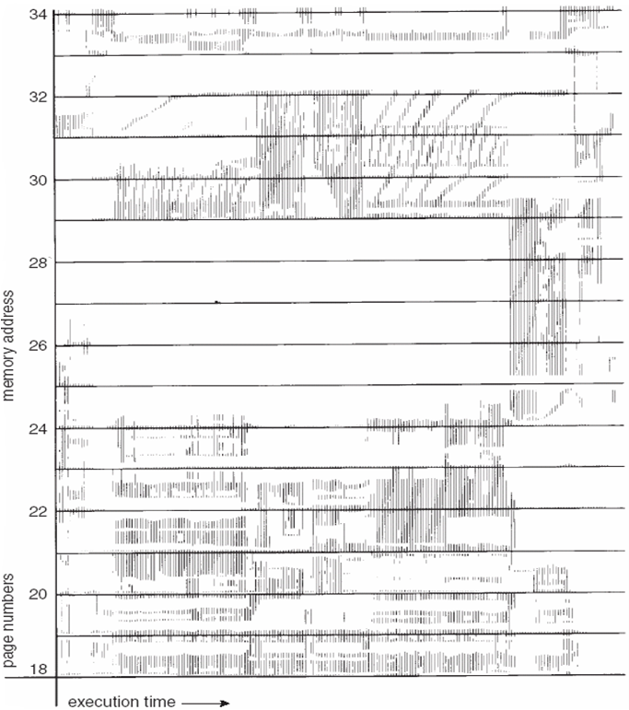
Locality In A Memory-Reference Pattern
Notes:
x:執行的時間軸 左進行到右 y:mem addr 可以看出執行的過程中 一段時間內容易有一個區域的y軸經常被用到 > locality 如果非常散就是沒有locality

Slide 48
Working-Set Model
Δ ≡ working-set window ≡ a fixed number of page references, Example: 10,000 instruction
WSS_{i} (working set of Process P_{i}) = total number of pages referenced in the most recent Δ (varies in time)
if Δ too small will not encompass 包含 entire locality
if Δ too large will encompass several localities
if Δ = ∞ ⇒ will encompass entire program
D = Σ WSS_{i} ≡ total demand frames 見註解
if D > m ⇒ Thrashing
Policy if D > m, then suspend one of the processes
Notes:
working set跟 locality有關 ex前面長方形區域 只要給他y寬度長的frame數量 就可以在那個範圍內都不會page fault 所以WS model 就是OS會觀察過去執行歷史 的分布 來決定當下要給幾個frame working Set Window : 觀察多少時間的分布 決定要給幾個Frame 這個window有點像是觀景窗的意思 例如往前看10000個instr他們的分布
D = Σ WSS_{i} 就是例如一個當下 proc1 就 5 frame p2 3 frame p3 10frame 那就是全部加起來 的數字 有給到 就不會page fault

Slide 49
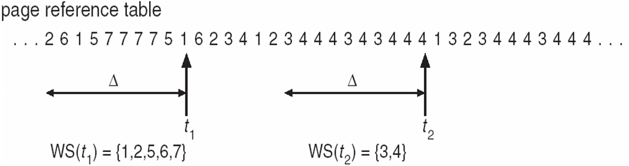
Working-set model
Notes:
從t1往前看delta個指令 就是用到位址 1 2 5 6 7 如果delta太小 可能就沒辦法包含到所有用到的位址

Slide 50
Keeping Track of the Working Set
Approximate with interval timer + a reference bit
Example: Δ = 10,000
Timer interrupts after every 5000 time units
Keep in memory 2 bits for each page
Whenever a timer interrupts copy and set the values of all reference bits to 0
If one of the bits in memory = 1 ⇒ page in working set
Why is this not completely accurate?
Improvement = 10 bits and interrupt every 1000 time units

Slide 51
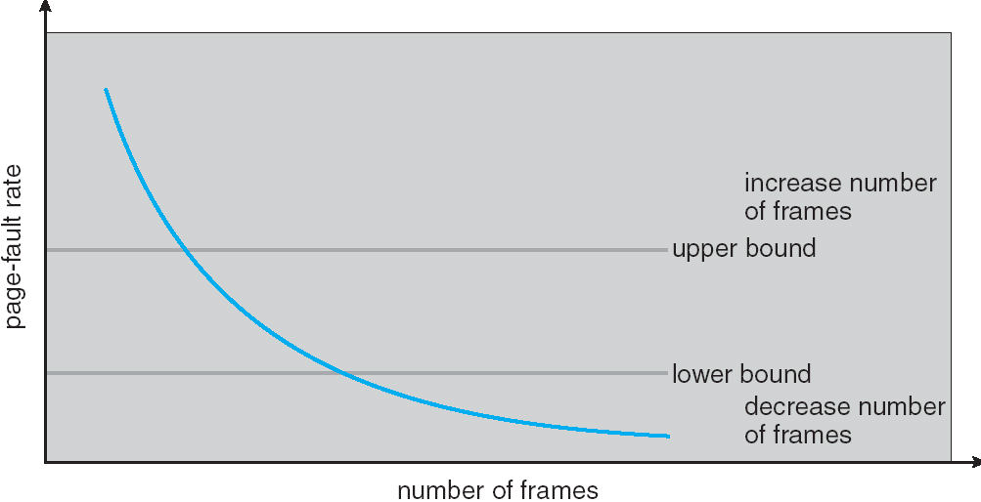
Page-Fault Frequency Scheme
Establish “acceptable” page-fault rate
If actual rate too low, process loses frame
If actual rate too high, process gains frame
Notes:
5-13 page fault的 upper bound 太高 就是Thrashing 太低都沒有fault 怎麼可能 一個proc都不產生fault 代表可能把整個proc都放到mem 代表proc總數少 > CPU使用率可能很低 multi programming 的效果不好 兩線中間就是可接受的值 太高處理方式就是 把proc搬出去 把空出來的frame分配給剩下的proc 增加frame數 page fault太低 就多家一些程式進來 然後把現有的程式的frame都抽一點出來 分配給新進來的 保持在上下限之間

Slide 52
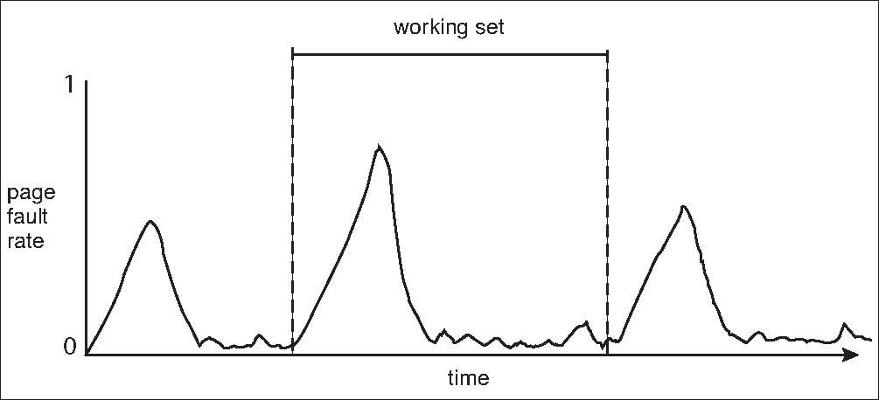
Working Sets and Page Fault Rates
Notes:
一個working set 一開始都沒裝位址 所以位址一直處理 會一直page fault 後來慢慢把用到的都抓到了 page fault 就掉下來 接著移到另一個loca 就又升上去 所以delta太大 可能跨多個loc 太小不夠 無限大就整個程式

Slide 53
Memory-Mapped Files
Memory-mapped file I/O allows file I/O to be treated as routine memory access by mapping a disk block to a page in memory mem當disk用
A file is initially read using demand paging用到才搬到mem. A page-sized portion of the file is read from the file system into a physical page. Subsequent reads/writes from/to the file are treated as ordinary普通的 memory accesses.
Simplifies file access by treating file I/O through memory rather than read(), write() system calls
Also allows several processes to map the same file allowing the pages in memory to be shared
Notes:
第一次抓file 在disk的block 就算是一種page fault 然後載到記憶體來 以後使用就到mem抓 用完在搬回硬碟 對mem讀寫會比disk快很多

Slide 54
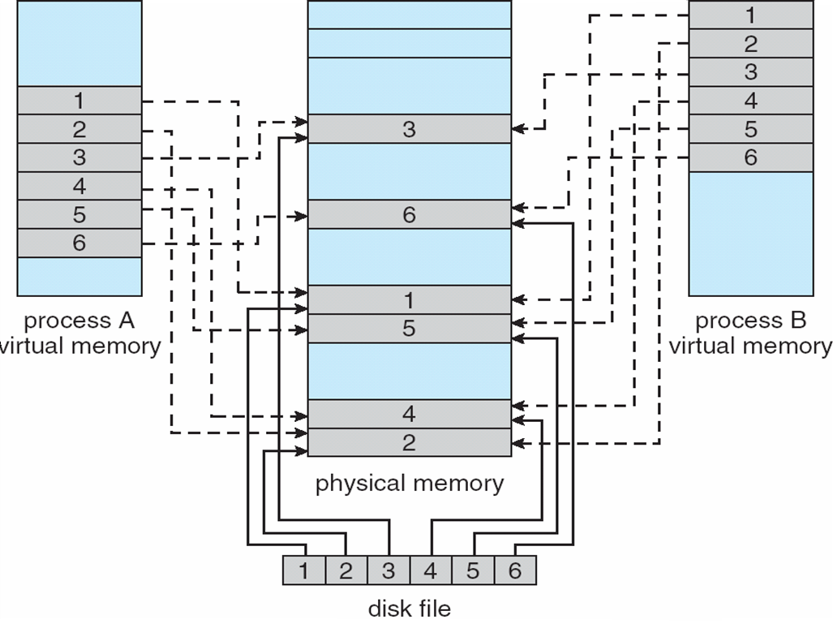
Memory Mapped Files
Notes:
左右AB proc 的6個page分別對應到mem 不用到disk抓

Slide 55
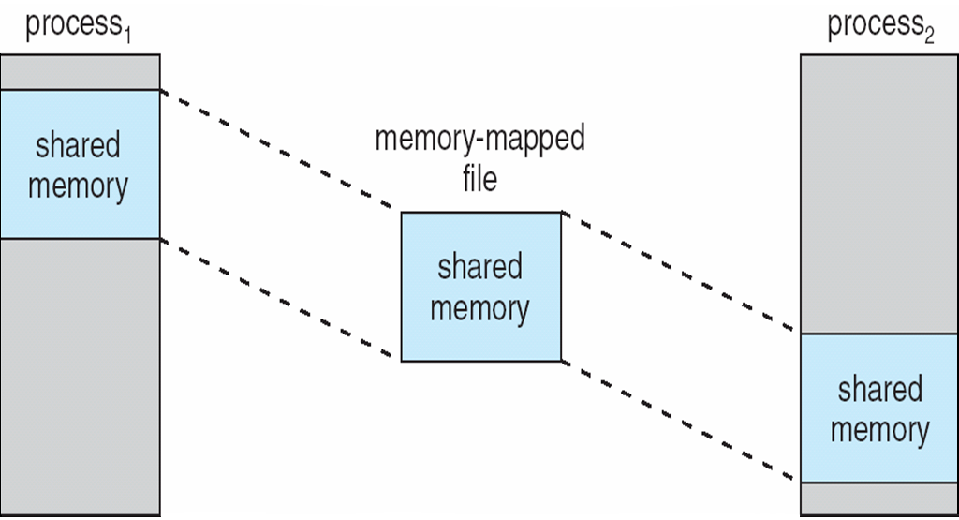
Memory-Mapped Shared Memory in Windows
Notes:
9-14 share mem

Slide 56
Allocating Kernel Memory
Treated differently from user mode memory (list of free..)
Often allocated from a free-memory pool
Kernel requests memory for structures of varying sizes, some of which are less than a page in size.
The kernel must use memory conservatively保存謹慎的 and attempt to minimize waste due to fragmentation.
Many OS do not subject kernel code or data to the paging system. subject to 服從
Some kernel memory needs to be contiguous鄰近連續的 due to certain hardware devices interact directly with physical memory – without the benefit of a virtual memory interface.
Two strategies: Buddy System and Slab Allocation
Notes:
第三點 大多數的OS 沒有使用paging (把程式切成page 記憶體切成frame 固定大小 一對一 重點是不用連續在一起 ) 避免segmentation 第四 exDMA 要把disk東西搬到mem 如果不連續那就很難處理 DMA應該要很快很快一直搬 virtual mem特性是彈性 可以只要部份程式在mem就能跑 程式能比mem大 但是不快 因為會有page fault

Slide 57
Buddy System
Allocates memory from fixed-size segment consisting of physically-contiguous pages
Memory is allocated from this segment using a power-of-2 allocator
Satisfies requests in units sized as power of 2
Request rounded up to next highest power of 2, for 11kB, it is satisfies with a 16-KB segment
When smaller allocation needed than is available, current chunk split into two buddies of next-lower power of 2
Continue until appropriate sized chunk available
Notes:
承上頁 所以需要連續的mem 此頁作法一 9-15

Slide 58
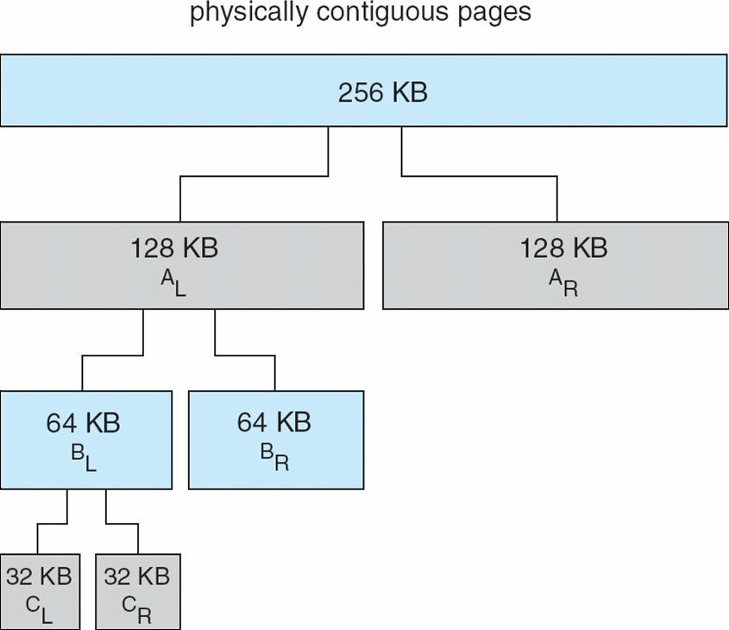
Buddy System Allocator
Assume a size of a memory segment is initially 256KB and the kernel requests 21 KB of memory. C_{L} is the segment allocated to this request.
Notes:
ex 有人需要32坪的K書座位 我有一間256坪的房子 用Buddy切如圖

Slide 59
Buddy System Allocator
An advantage of the buddy system is how quickly adjacent連續的 buddies can be combined to form larger segments using a technique known as coalescing.
coalesce vi. 聯合；連結
When kernel releases CL, 空出來 就跟附近的合併
C_{L}+C_{R} → B_{L},
B_{L}+B_{R} → A_{L},
A_{L} + A_{R} → 256KB segment.
Drawback: cause fragmentation within allocated segments.(32 – 21 internal fragmentation)
The next one is a memory allocation scheme where no space is lost due to fragmentation

Slide 60
Slab厚板 Allocation
Slab is one or more physically contiguous pages
Cache consists of組成 one or more slabs
Single cache for each unique kernel data structure
A separate cache for the data structure representing process descriptor
A separate cache for file objects
A separate cache for semaphores
Each cache filled with objects – instantiations of the kernel data structure the cache represents.
Notes:
每一種資料結構都有對應的Cache 每個Cache就是放資料結構的instance 這邊沒有講很多 直接看下頁

Slide 61
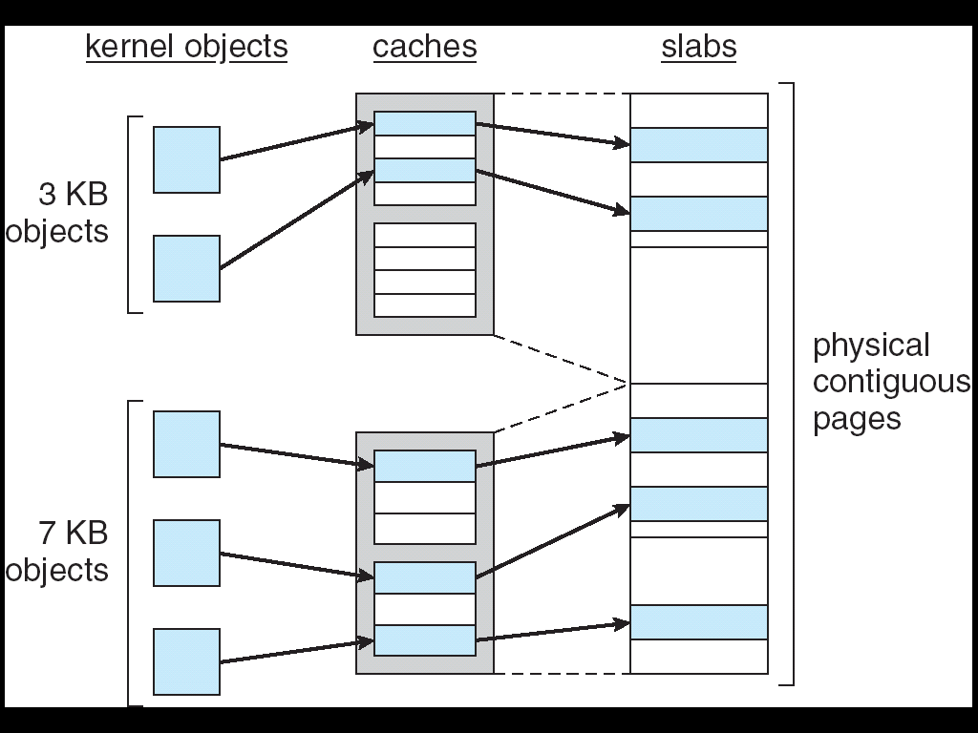
Slab Allocation
Notes:
每個slab 是一或多個page 像右上角的slab就有4 pages 左邊兩種不同的資料結構 就用不同的Cache來裝 Cache的大小是好幾個slab

Slide 62
Slab厚板 Allocation
The slab-allocations algorithm uses caches to store kernel objects
When a cache is created, a number of objects are allocated to the cache (initially marked as free).
The number of objects in the cache depends on the size of the associated slab. A 12-KB slab can store six 2-KB objects.
objects > cache > slab
Notes:
Slab是連續的 例如一個cache放proc的descriptor 另一個可能存file object 另個可能存sempahore 他們的Size可能不同 存到不同的Cache object就是資料結構的instance實體 Slab就是一或多個連續的page

Slide 63
Slab Allocation
When a new object for a kernel data structure is needed, the allocator can assign any free object from the cache to satisfy the request.
The object assigned from the cache is marked as used
If slab is full of used objects, next object allocated from empty slab
If no empty slabs, new slab allocated
Two main benefits
No memory is wasted due to fragmentation.因為slab單位是page 每個page都分配出去
Memory request can be satisfied quickly. (Objects are created in advance and thus can be quickly allocated from cache)水喔
Notes:
淺顯易懂9-16

Slide 64
Other Issues -- Prepaging
Prepaging
To reduce the large number of page faults that occurs at process startup Prepage all or some of the pages a process will need, before they are referenced
But if prepaged pages are unused, I/O and memory was wasted
Assume s pages are prepaged and α of the pages is used
Is cost of s * α save pages faults > or < than the cost of prepaging s * (1- α) unnecessary pages?
α near zero ⇒ prepaging loses
Notes:
減少第一次的fault 也就是不是等一開始要用才去拿產生fault 是預先下載好

Slide 65
Other Issues – Page Size
Page size selection must take into consideration:
fragmentation ex page size太大 只裝一個小程式 那就造成很大的internal fragme
table size page table大小 page size小 table的紀錄資料就多 反之亦然
I/O overhead 天花板 demand page越多 IO就越大
locality page size越大 同一大小的locality用到的page數量就越小
Notes:
page size不同OS 從幾百byte 到幾KByte都有

Slide 66
Other Issues – TLB Reach
TLB Reach - The amount of memory accessible from the TLB (translation look-aside buffers, Chapter 8 )
TLB Reach = (TLB Size) X (Page Size)
Ideally, the working set of each process is stored in the TLB, otherwise there is a high degree of page faults
Increase the Page Size
This may lead to an increase in fragmentation as not all applications require a large page size ok
Provide Multiple Page Sizes
This allows applications that require larger page sizes the opportunity to use them without an increase in fragmentation ok
Notes:
TLB算是平行比對的mem功能 常用到的page 放到

Slide 67
Other Issues – Program Structure
Program structure
Int[128,128] data;
Each row is stored in one page (need 128 pages to store)
Program 1
for (j = 0; j <128; j++) for (i = 0; i < 128; i++) data[i,j] = 0;
128 x 128 = 16,384 page faults
Program 2
for (i = 0; i < 128; i++) for (j = 0; j < 128; j++) data[i,j] = 0;
128 page faults
Notes:
每一列是一個page 由上到下會一直切換page所以每次都會falut 由左到右在往下換列則只要128次 不過實際上OS怎麼排page我們可能不知道

Slide 68
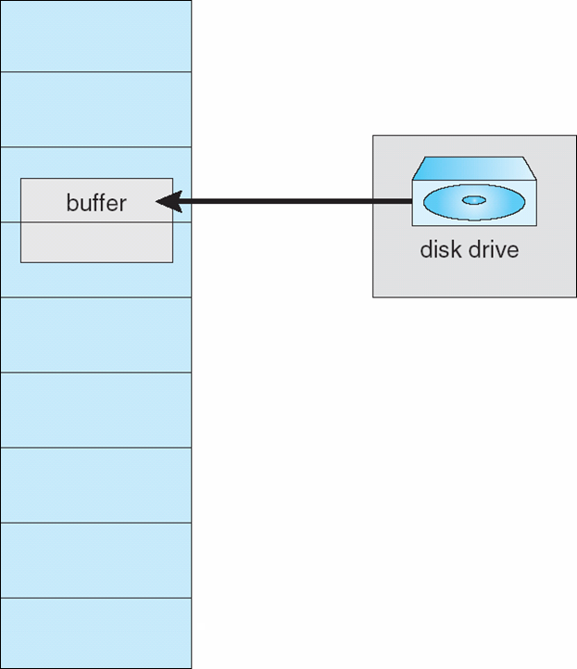
Other Issues – I/O interlock
I/O Interlock – Pages must sometimes be locked into memory
Consider I/O - Pages that are used for copying a file from a device must be locked from being selected for eviction逐出,收回 by a page replacement algorithm
Notes:
9-18 disk寫到mem時 也就是IO的時候 buffer要lock住 避免搬動 以保持寫入位置

Slide 69
Operating System Examples
Windows XP
Solaris

Slide 70
Windows XP
Uses demand paging with clustering. Clustering brings in pages surrounding the faulting page
Processes are assigned working set minimum and working set maximum
Working set minimum is the minimum number of pages the process is guaranteed to have in memory
A process may be assigned as many pages up to its working set maximum
When the amount of free memory in the system falls below a threshold, automatic working set trimming is performed to restore the amount of free memory
Working set trimming removes pages from processes that have pages in excess of their working set minimum
Notes:
第一點 發現某一點fault 讀的時候就把附近的一起讀進來 類似locality 給這兩個參數 都是FrameNumber 知道分配多少個frame min是說最少有多少個page max最多多少
五點 least of free mem太低 會回收一些proc裡面超過min的回來(六點) 分給其他人以提升 或是給新的proc

Slide 71
Solaris
Maintains a list of free pages(空的記憶體) to assign faulting processes (threads)
Lotsfree – threshold parameter (amount of free memory, usually 1/64 of the physical memory) to begin paging
Desfree – threshold parameter to increasing paging (from 4 times to 100 times/sec)
Minfree – threshold parameter to begin swapping processes, thereby freeing all pages allocated to the swapped processes. swap out 放到硬碟 暫停執行
Paging is performed by pageout process
Pageout scans pages (four times per second) using modified clock algorithm (two hands)
Notes:
paging其實有回收的意思 二點是說 mem空位還多於1/64時 有人要就給 快用光了才開始paging 這邊回收速度比較慢 到了三點第二個更低的門檻 加快回收速度 (一秒回收4~100次 意思類似之前說的 每次掃過去就reference bit 1變0 和 0變回收 1>0 0還是0就代表沒用到 )

Slide 72
Solaris
The front hand scans the pages and sets the ref bit to 0
The back hand checks and appends each page with ref bit still equals 0 to the free list.
Handspread: the distance (in pages) between the two hands
Scanrate is the rate at which pages are scanned. This ranges from slowscan (100 pages/sec) to fastscan (up to 8192 pages/sec)
The amount of time between the two hands depends on scanrate and handspread. For scanrate = 100/sec, handspread = 1000 pages, we have 10 sec. ok
Pageout is called more frequently depending upon the amount of free memory available ok
Notes:
前手後手以x軸為例 就是 一個在3 一個在9 同時往左或右移動 一個系統的page可以到上百萬

Slide 73
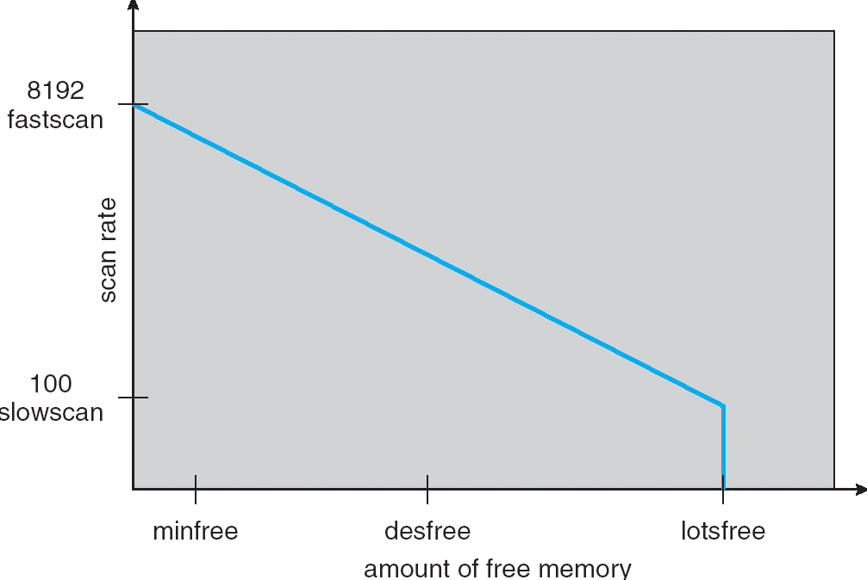
Solaris 2 Page Scanner
begin paging
begin swapping
Increasing paging

Slide 74
End of Chapter 9

